Slide 1
Study Unit 6 Basic SQL in Python

Slide 2
Introduction to SQL and SQLite3

Slide 3
Introduction to SQL and SQLite3
SQL (Structured Query Language) is a programming language designed for database management.
In Python, the SQLite3 package allows us to embed SQL codes in Python programs to facilitate connections to databases and query data in it.
SQLite3 is a built-in package of Python. Hence, no installation is needed.
SQLite3 works hand-in-hand with the pandas packages since both of them are designed for data management.
We can convert output tables of SQL queries to pandas DataFrames and vice versa anytime.

Slide 4
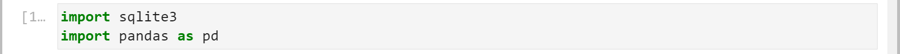
Import SQLite3
Use the import syntax to load sqlite3 into the program.
Import sqlite3 and pandas:
import sqlite3

Slide 5
Creating Data Files in Python (I)
Data entered by users at runtime can be stored in, e.g., .csv text files. Text files are good medium of data storage due to high compatibility.
Almost every software such as Excel, SPSS, SAS, etc. has a module to convert text files into their own data file format.
Text files are also the most suitable format for data exchange since their size is usually small so that they can be uploaded and downloaded easily.
To store data in a text file, we need to open it with open() first.
The with statement is used in combination with the open() function.
Data in the text file will be stored in file_object for further processing.
with open("file_name", mode = "mode_str") as file_object: instructions

Slide 6
Creating Data Files in Python (II)
We can also choose the permitted operations that we can carry out with the file. Here is a list of some of the available modes:
Character | Description
"r" | open for reading (default)
"x" | open for exclusive creation, failing if the file already exists
"w" | open for writing, truncating the file first
"a" | open for writing, appending to the end of the file if it exists
"+" | open for updating without truncation (reading and writing)

Slide 7
Work with Text File Data
Write the user-entered data to the text file with .write().
After all data have been saved to the file_object, we need to close the file properly to release its access to other parties.
Use a for-loop to go through the existing entries in a text file line by line and print the content to the screen.
file_object.write(data_row)
file_object.close()
for line in file_object: print(line)

Slide 8
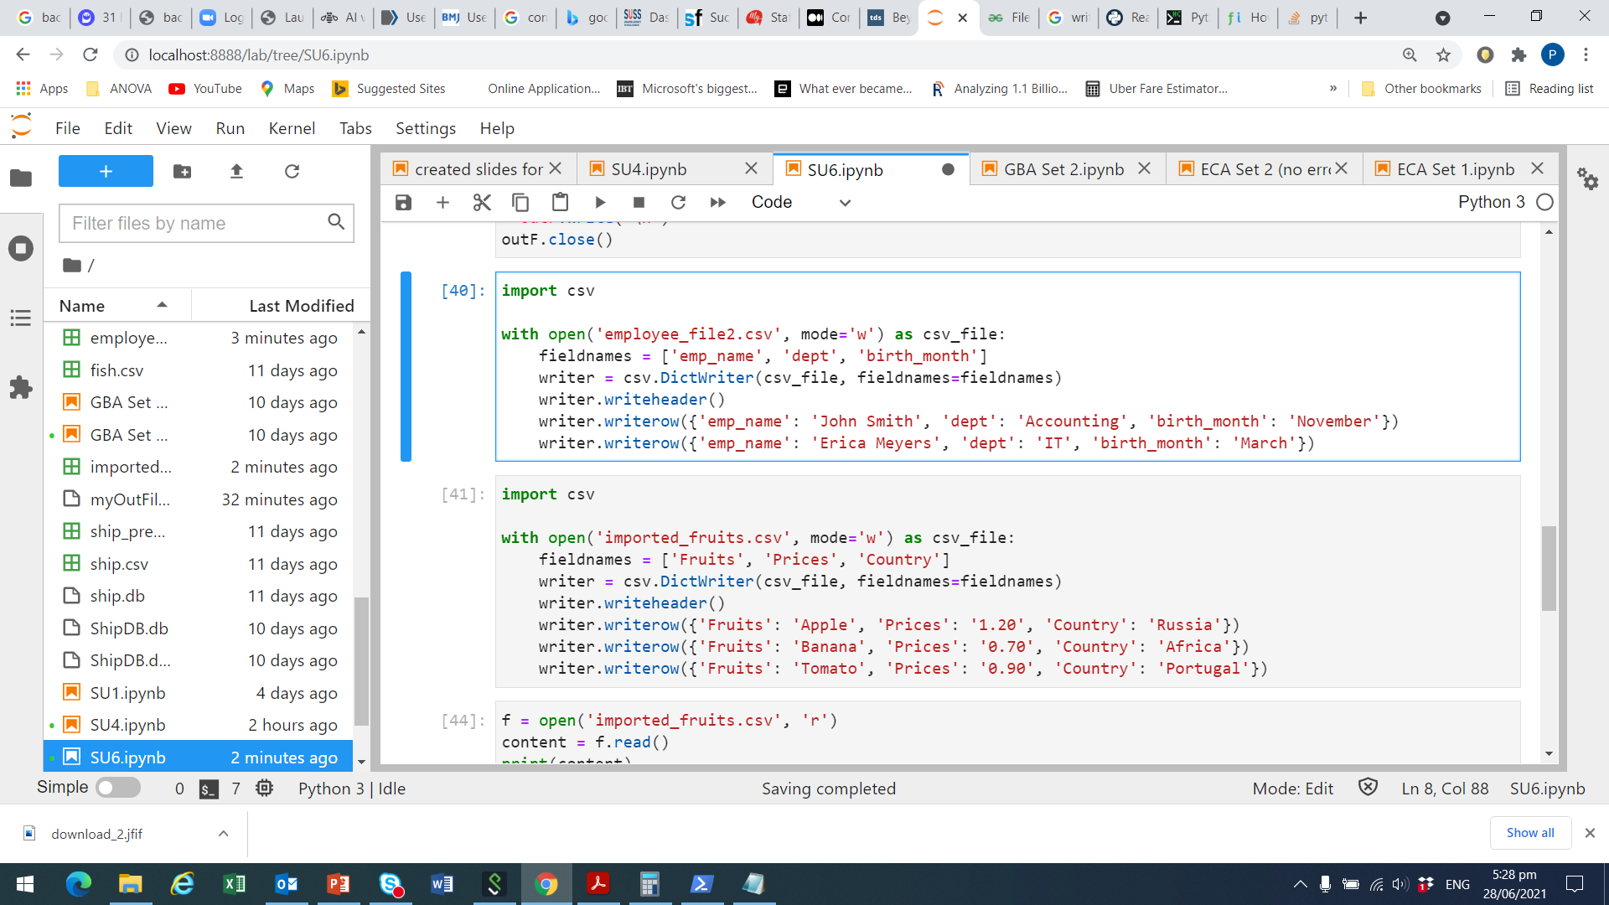
Example: Open and Write (I)
First import csv module as we are creating a csv object
Next, open a new file which is saved as ‘imported_fruits.csv’ on our computer, choose mode = ‘w’ for writing, and name the object as ‘csv_file’
Create the variable names, which is stored in the list fieldnames
Write the data as a dictionary, with the variable names defined earlier

Slide 9
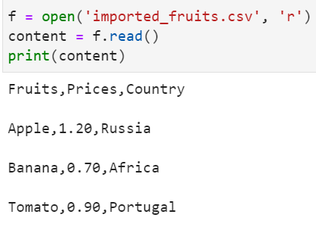
Example: Open and Write (II)
Fill in the data entries for our fruits, prices, and countries
Check if the csv is correctly created, by opening, reading and printing it

Slide 10
Connect Python to Database
First, generate a “connection” from Python to the databases by the connect() function of the sqlite3 package.
Then, create SQL syntaxes as strings or string variables in Python and send them to SQL for execution by a cursor object.
The cursor object is created by the .cursor() method.
connection_object = sqlite3.connect("database_name")
cursor_object = connection_object.cursor()

Slide 11
Export Data to Database
To create a table from a .csv file, read in the file as a pandas database in Python first, then send the data object to the database by .to_sql().
We can choose to replace ("replace"), append ("append"), or let Python create an error message ("fail") if a table already exists in the database.
data_object = pandas.read_csv("csv_file_name.csv")
data_object.to_sql("table_name", connection_object, if_exists)

Slide 12
Query Data from Database
Execute SQL commands through the cursor object with .execute().
Send a SELECT statement to SQL to select a table from the database.
Once a table is selected, we can print one record of the result to the screen by the .fetchone() method.
Use the .fetchall() method to print all records from a query result.
After applying .fetchone() or .fetchall(), records are no longer available.
cursor_object.execute("SQL_command_string")
SELECT * FROM table_name;
cursor_object.fetchone()
cursor_object.fetchall()

Slide 13
Activity 1
Car sales program:
Carry out the following tasks in JupyterLab:
Modify the program created in Study Units 1 & 2 in a way that the user can enter the brand, model, buying price and satisfaction rate (1 = “totally dissatisfied”, …, 5 = “totally satisfied”) of the car he purchased.
Save the input as “car_purchase” in a text file (preferably .csv file).
Create a database and export the data to it.
Export the original data of “car_model” and “car_price” from Study Unit 4 to the database as well.

Slide 14
Discussion
Why is .csv file a good medium of data storage in comparison to other formats?
What are the components of the SQLite3 package which regulate the “communication” between a Python program and a database?

Slide 15
The rest of Study Unit 6 is Optional

Slide 16
Data Query

Slide 17
Extract Variable Names from a Table
The SELECT statement also allows us to select some of the variables from the table instead of all of them.
But in some cases, we may not even know the variables that the table contains or how their names are correctly spelt.
We can use .description to extract the variable from the last queried table.
The returned object is a collection of tuples where the first item of each tuple is the column name, and the last six items are None.
cursor_object.description

Slide 18
Store Query Result as DataFrame
It may be desirable to store the result of an SQL query in a pandas DataFrame. In fact, we can use .from_records() for this purpose.
The .from_records() method is actually created to convert structured or n-dimensional record arrays to pandas DataFrames.
We can specify our own column names of the output DataFrame. If not, the corresponding column names are simply the column indices.
query_object = pd.DataFrame.from_records (data = cursor_object.fetchall(), columns)

Slide 19
Sort Data
We can add the keyword ORDER BY to the SELECT statement to sort the data of a table by some of its variables.
To sort a table by multiple variables, separate their names by commas.
The sequence of the sorting variables reflects the sorting hierarchy.
To sort in descending order by a particular variable, specify the DESC option behind the variable name.
SELECT * FROM table_name ORDER BY var1_name, var2_name ASC|DESC

Slide 20
Filter Data
More often, we do not query data of the entire table.
Instead, we are searching for records that fulfil certain criteria.
In SQL, use the WHERE clause in the SELECT statement to filter the useful records for us.
SELECT * FROM table_name WHERE var_name = value;

Slide 21
Operators in the WHERE Clause
Here is a list of the operators used in the WHERE clause:
(Source: https://www.w3schools.com/sql/sql_where.asp)
Operator | Description
= | Equal
> | Greater than
< | Less than
>= | Greater than or equal
<= | Less than or equal
<> | Not equal (In some SQL versions it may be written as !=)
BETWEEN | Between a certain range
LIKE | Search for a pattern
IN | To specify multiple possible values for a column

Slide 22
Filter Missing Data
We can connect multiple criteria in one statement by linking them with the AND, OR and NOT operators.
Sometimes, we would rather not obtain records that contain missing values in one or more variables from a query.
Use the IS NOT NULL syntax with the SELECT statement for this query.
Without the NOT operator, SQL returns all records with missing values in the variable var_name to us.
SELECT * FROM table_name WHERE var_name IS NOT NULL;

Slide 23
Select Variables from Table
We can select particular columns from a table in the data query.
The asterisk (*) in the SELECT statement is replaced by a list of selected variables in this case.
We can also create our own variable list as string in our Python program first and then combine it with the rest of the statement.
SELECT var_name1, var_name2, …
FROM table_name WHERE criteria;

Slide 24
Activity 2
Car sales program:
Carry out the following tasks in JupyterLab using SQL statements:
Select all records with the value “Sedan” or “SUV” in the variable “Category” from the table “car_model”.
Select all cars that costs more than USD 50,000.00 from the table “car_price”.
Select all records in which the users were “totally dissatisfied” with the purchased cars from the table “car_purchase”.

Slide 25
Join Tables

Slide 26
Inner Join with ON
The inner join method is to join two tables with only common rows and columns in the output table.
The INNER JOIN clause is used within the SELECT statement.
It selects only records of table1 that can be matched by records in table2.
SQL compares the values of the matching variable from the two tables. And the matching condition is provided after the ON keyword.
The name of the original table must be specified before each matching variable and separated by a dot (.).
SELECT * FROM table1_name
INNER JOIN table2_name
ON table1_name.match_var = table2_name.match_var;

Slide 27
Inner Join with USING
With the ON keyword, the matching variables do not need to have the same name in their original tables.
But if they do, we can shorten the syntax above by the USING keyword.
The name of the original table does not need to be mentioned in the bracket of the USING keyword.
Both matching variables are included in the output table when using ON.
Only the matching variable of table1 remains when applying USING.
If more than one records in table2 are matching to a record in table1, each of them will be appended to a copy of the record in table1.
SELECT * FROM table1_name
INNER JOIN table2_name USING(match_var);

Slide 28

Visual Example: Inner Join
Only matching records in Tables A and B are retained

Slide 29
Left Join
Another way to join multiple tables of a database is the left join method.
The options alias1 and alias2 are references of table1 and table2 and is useful when two variables in both tables have the same name.
The aliases are applicable to any SELECT statement.
In left join, SQL searches for records from table2 that match the records from table1 based on the matching condition.
SELECT * FROM table1_name
LEFT JOIN table2_name
ON table1_name.match_var = table2_name.match_var;
SELECT * FROM table1_name
LEFT JOIN table2_name USING(match_var);

Slide 30

Visual Example: Left Join
All records in Table A and, matching records in B are retained

Slide 31
Cross Join
Cross join produces cartesian product of the involved tables.
Every record of table1 is merged with all records of table2.
In other words, if table1 and table2 have m and n records, respectively, there will be a total of m×n records in the output table.
No matches are required here.
SELECT * FROM table1_name
CROSS JOIN table2_name;

Slide 32
Outer Join
Outer join produces the union of the involved tables.
Records from both tables regardless of any matches will also be carried over in the output table.
In SQLite3, we need to combine LEFT JOIN with UNION ALL to outer join two tables.
SELECT var_list FROM table1_name alias1 LEFT JOIN table2_name alias2 USING(matching_var) UNION ALL SELECT var_list FROM table2_name alias2 LEFT JOIN table1_name alias1 USING(matching_var) WHERE alias1.var_name IS NULL;

Slide 33

Visual Example: Outer Join
All records from Tables A and B are retained

Slide 34
Activity 3
Car sales program:
Carry out the following tasks in JupyterLab using SQL statements:
Join the tables “car_model”, “car_price” and “car_purchase” such that we can determine the difference between the purchase price and selling price.
Join the tables “car_model”, “car_price” and “car_purchase” such that we can determine some statistics on the customer satisfaction for each car category.

Slide 35
Group Data

Slide 36
Combine Records into Groups
Add the GROUP BY statement to the SELECT statement to group records of a table together.
We can specify the aggregate function and the variables for which the aggregated statistics should be calculated in the variable list.
The GROUP BY statement is followed by the variable names based on which the groups should be formed.
SELECT var_list AGGREGATE_FUNCTION(var_name) FROM table_name GROUP BY groupvar1_name, groupvar2_name, …;

Slide 37
Aggregate Functions in SQL
Here is a list of the aggregate functions in SQL:
Functions | Description
AVG | Average of the specified columns in a group
COUNT | Number of rows in a group
MAX | Maximum value of the specified columns in a group
MIN | Minimum value of the specified columns in a group
STDDEV | Standard deviation of the specified columns in a group
SUM | Sum of the specified columns in a group
VARIANCE | Variance of the specified columns in a group

Slide 38
Filter Groups
We can also filter the grouped data by some specified conditions. The filtering process for grouped data is carried out by the HAVING clause.
It is also possible to extend this SELECT statement with other keywords such as WHERE, ORDER BY, INNER JOIN/LEFT JOIN/CROSS JOIN, etc.
SELECT var_list AGGREGATE_FUNCTION(var_name) FROM table_name GROUP BY groupvar1_name, groupvar2_name, …
HAVING conditions;

Slide 39
Edit Data

Slide 40
Insert Records
To insert new records to a table, we can use the INSERT INTO statement.
The number of values in value_list must be identical with the number of variables in var_list. Both lists must be put in parentheses.
The sequence of the elements in value_list should correspond to the sequence of the variables in var_list.
To insert multiple records, the values of each record must be put as a list in a pair of brackets. These lists must be comma separated.
Values of variables excluded in the INSERT INTO statement for the new records will be None.
INSERT INTO table_name (var_list) VALUES (value_list);

Slide 41
Update Records
Update or edit data of existing records by the UPDATE statement.
We need to state certain conditions in a WHERE clause which must be fulfilled by a record in order to get itself updated.
If the condition is true for more than one records, all of them will be modified simultaneously.
All records in the table will be updated if the WHERE clause is omitted.
Specify the columns to be updated and their new values by the keyword SET.
UPDATE table_name SET var1_name = value1, var2_name = value2, … WHERE condition;

Slide 42
Delete Records
Deleting records from a table when records fulfil certain conditions.
It is very important to specify the correct records for deletion.
If the condition is too vague, there can be more records deleted than originally intended.
Once a row has been dropped from a table, it cannot be undone in SQL.
DELETE FROM table_name WHERE condition;

Slide 43
Add and Rename Columns
With the ALTER TABLE statement, we can rename a table, rename a column, or add a column.
To add a column to a table, include ADD to the ALTER TABLE statement.
Rename a column with the following ALTER TABLE statement.
Note that we can only add or rename one column at a time.
ALTER TABLE table_name ADD column_name;
ALTER TABLE table_name RENAME old_column_name TO new_column_name;

Slide 44
Alter Tables
Create a new table in the database by the CREATE TABLE statement:
It is also possible to drop a table from the database.
Rename a table by including RENAME TO in the ALTER TABLE statement.
Copy the data from one table to another one with the same column structure by combining the INSERT INTO with the SELECT statement:
CREATE TABLE table_name (column1_name, column2_name, …);
DROP TABLE table_name;
ALTER TABLE table_name RENAME TO new_table_name;
INSERT INTO target_table_name SELECT value_list FROM source_table_name;

Slide 45
Commit Changes in Database
We can query the names of the existing tables in a database from the master table sqlite_master by a SELECT statement.
The changes in the database so far are only stored in the virtual memory of our computer and not saved to the hard disk yet.
Before closing the database, commit all changes through the connection object back to the physical file of our database.
We cannot undo the changes in the tables once they are committed.
Finally, close the connection to the database by the .close() method.
SELECT name FROM sqlite_master WHERE type = 'table';
connection_object.commit()
connection_object.close()

Slide 46
Activity 4
Car sales program:
Carry out the following tasks in JupyterLab using SQL statements:
Create a new column with the purchase and selling prices in SGD and name the column accordingly.
Commit all the changes of the tables to the physical files of the database.

